Slide 1


Does[0]Compute
Working with Remote Machines & Git for Scientists
Erica Sun & Corey Carter

Slide 2
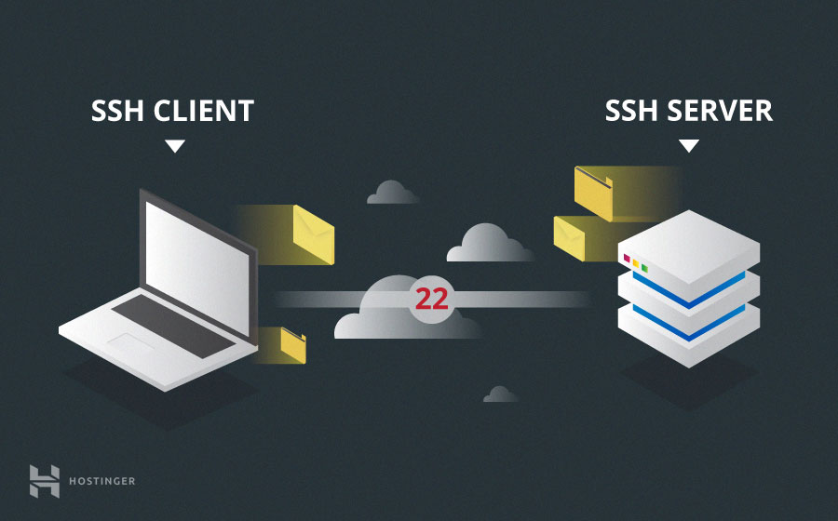

Remote Servers: MSI
SSH allows you to remotely connect to computers.
Does[0]Compute: Working with Remote Machines and Git for Scientists

Slide 3
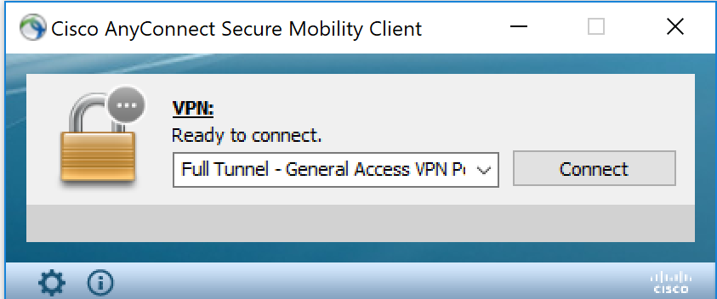

Remote Servers: MSI
University of Minnesota’s remote cluster is located at Walter Library.
It’s called the Minnesota Supercomputing Institute or MSI.
To operate first establish an account at MSI.
open a terminal environment:
Windows 10: Activate Windows Developer mode to use Ubuntu kernel
Search terminal in a Unix/Linux environment.
If you’re home you will have to use a VPN client, check MSI’s help site for instructions:
Search MSI VPN or copy this link:
https://it.umn.edu/service-details/virtual-private-network-vpn
Does[0]Compute: Working with Remote Machines and Git for Scientists

Slide 4
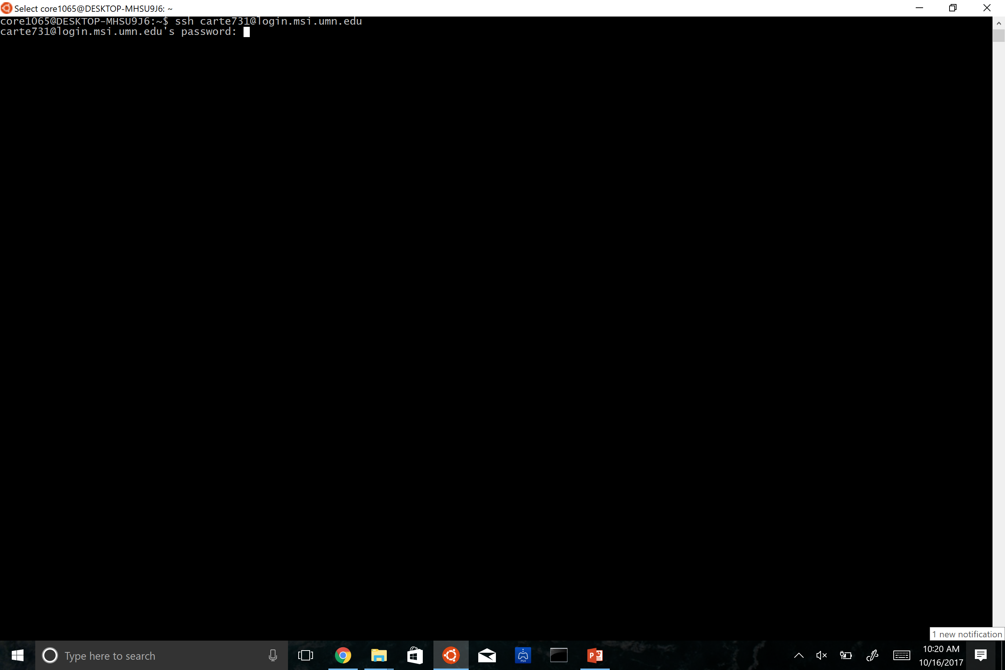
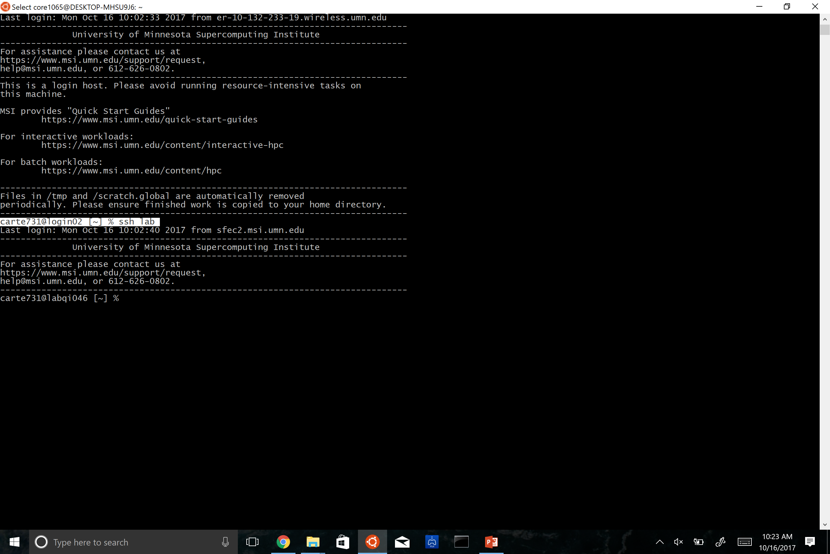

Remote Servers: MSI
‘ssh <username>@login.msi.umn.edu’
For first time users it will ask you to save the SSH keys, type ‘yes’.
This will save the unique security key to your computer.
Does[0]Compute: Working with Remote Machines and Git for Scientists

Slide 5
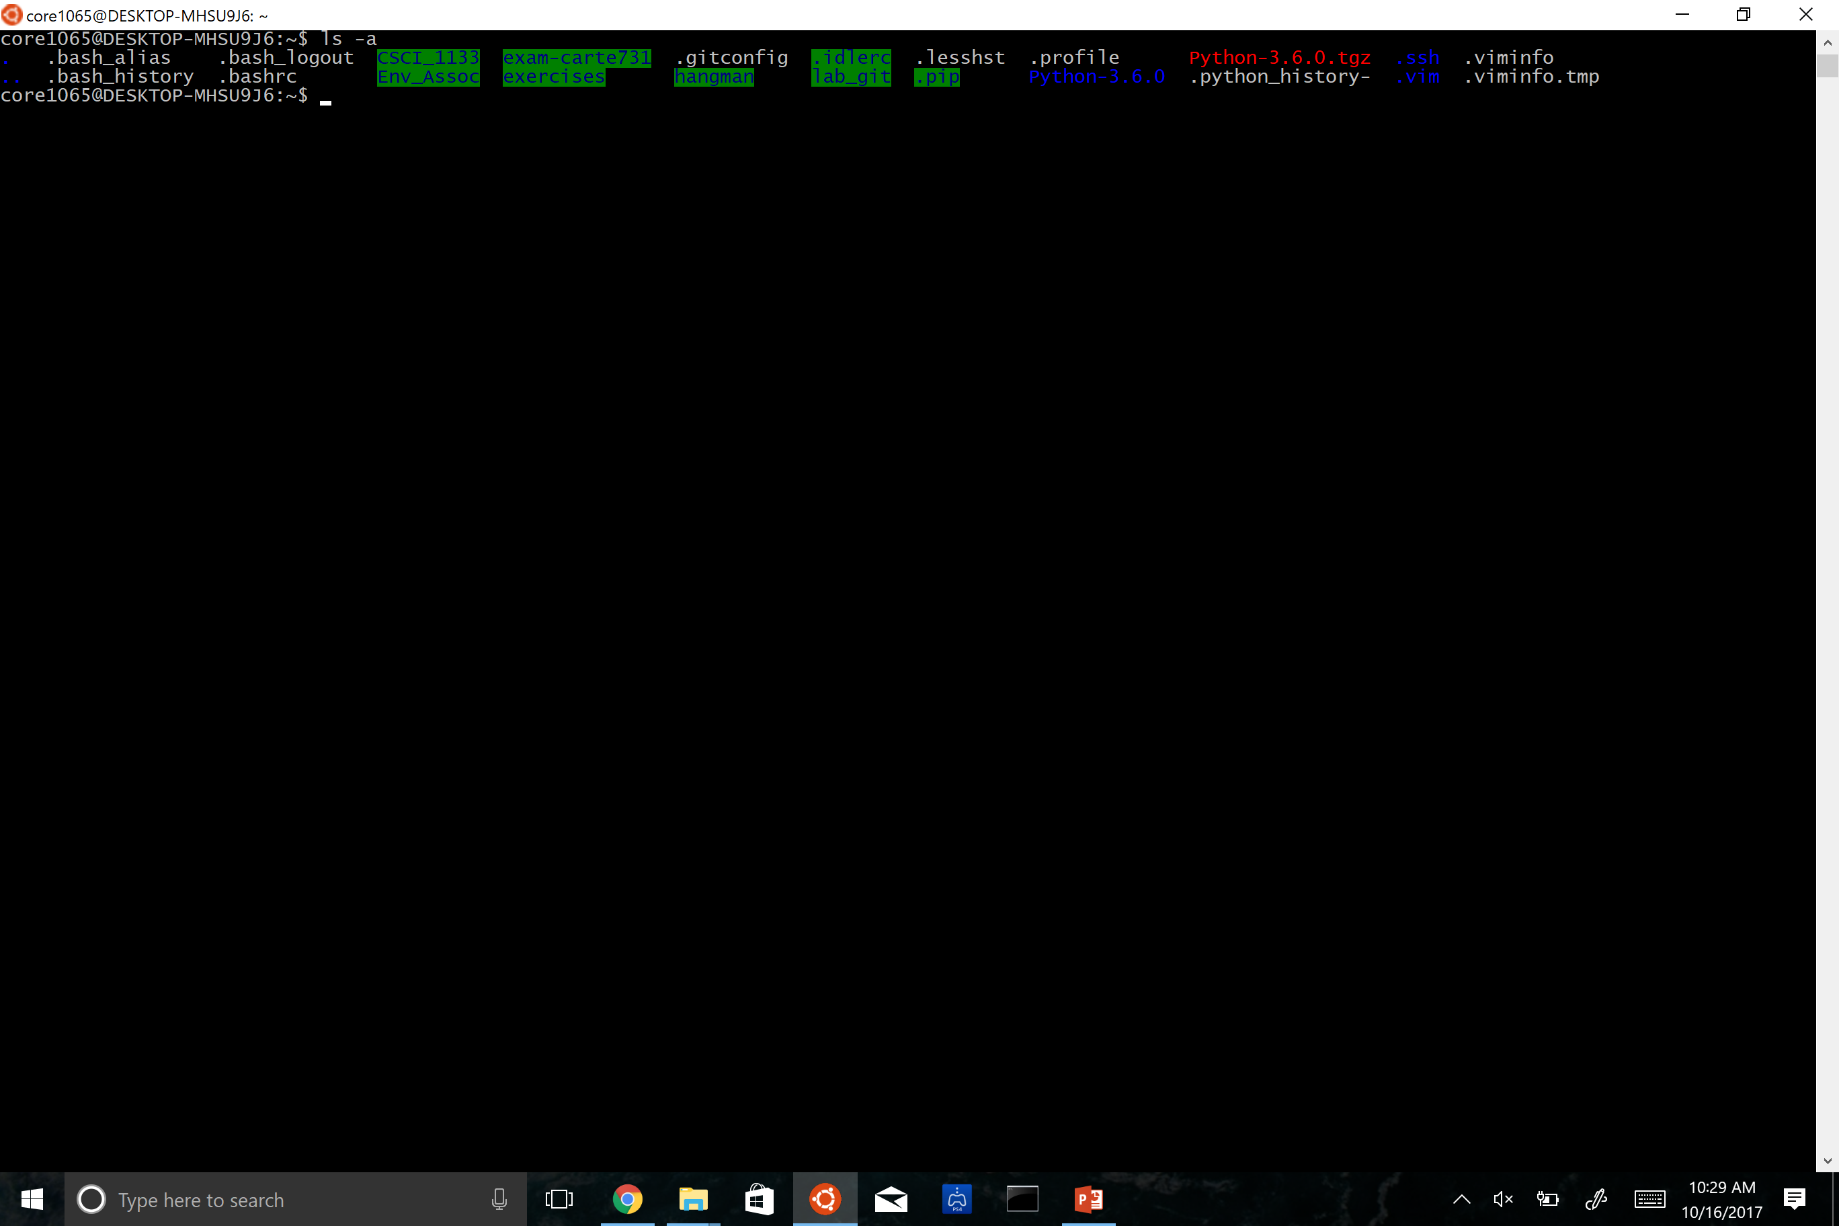
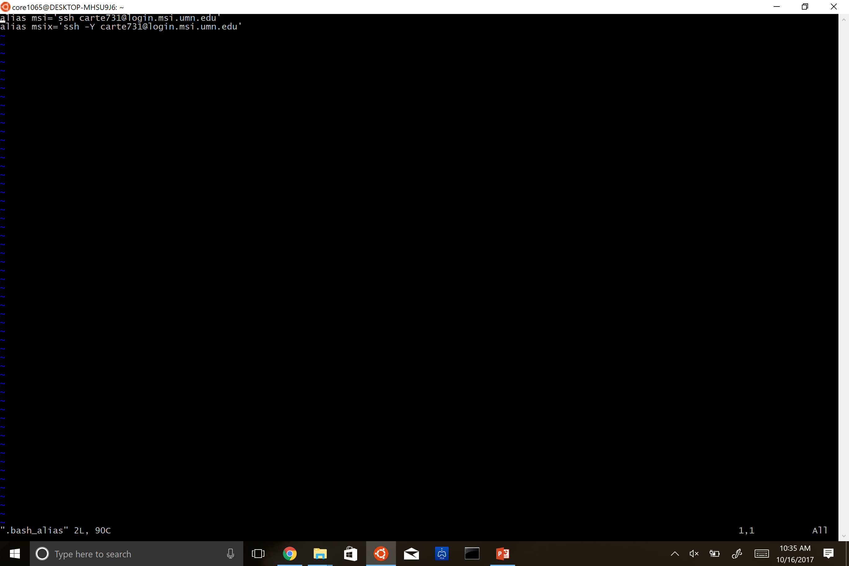

Remote Servers: Short-Cuts
In your home directory type ‘ls -a’. This shows hidden files.
Type vim and ‘.bashrc’ or ‘bash_alias’ if present. Example: ‘vim .bash_alias’
Scroll to the bottom and type:
‘i’ (insert mode)
Type: alias msi='ssh carte731@login.msi.umn.edu’
Esc (stops insert mode)
‘Shift’ + ‘;’
Type in: ‘wq’ which is save and quit. Or ‘q!’ to quit without saving.
Does[0]Compute: Working with Remote Machines and Git for Scientists

Slide 6
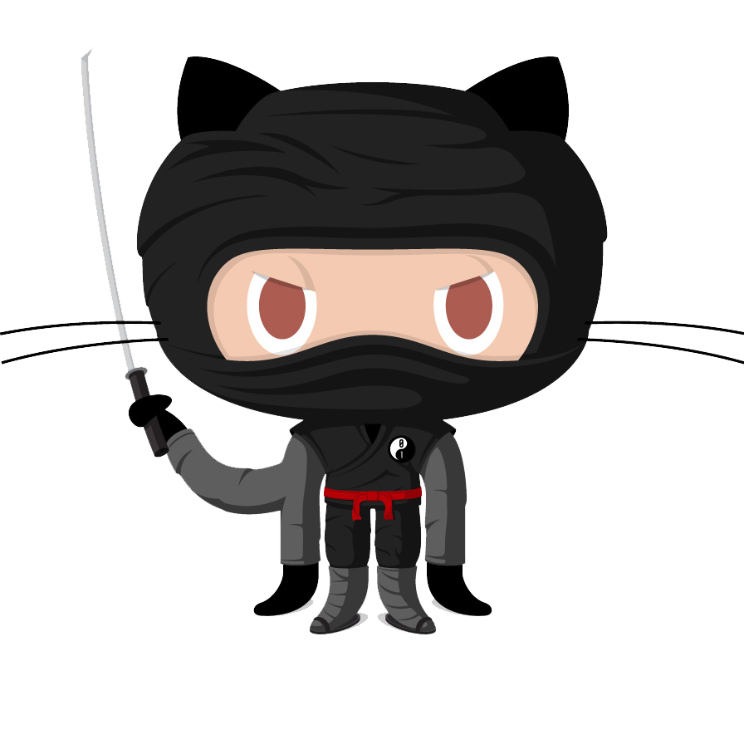
What is Git?
Version Control System (VCS)
Manage different versions of collaboratively edited code --> keep track of changes
Easily reproduce and rollback to past version of analysis → commits
Can look at when, what has changed
Repositories, Tracking Files, and Staging and Committing Changes
Does[0]Compute: Working with Remote Machines and Git for Scientists

Slide 7
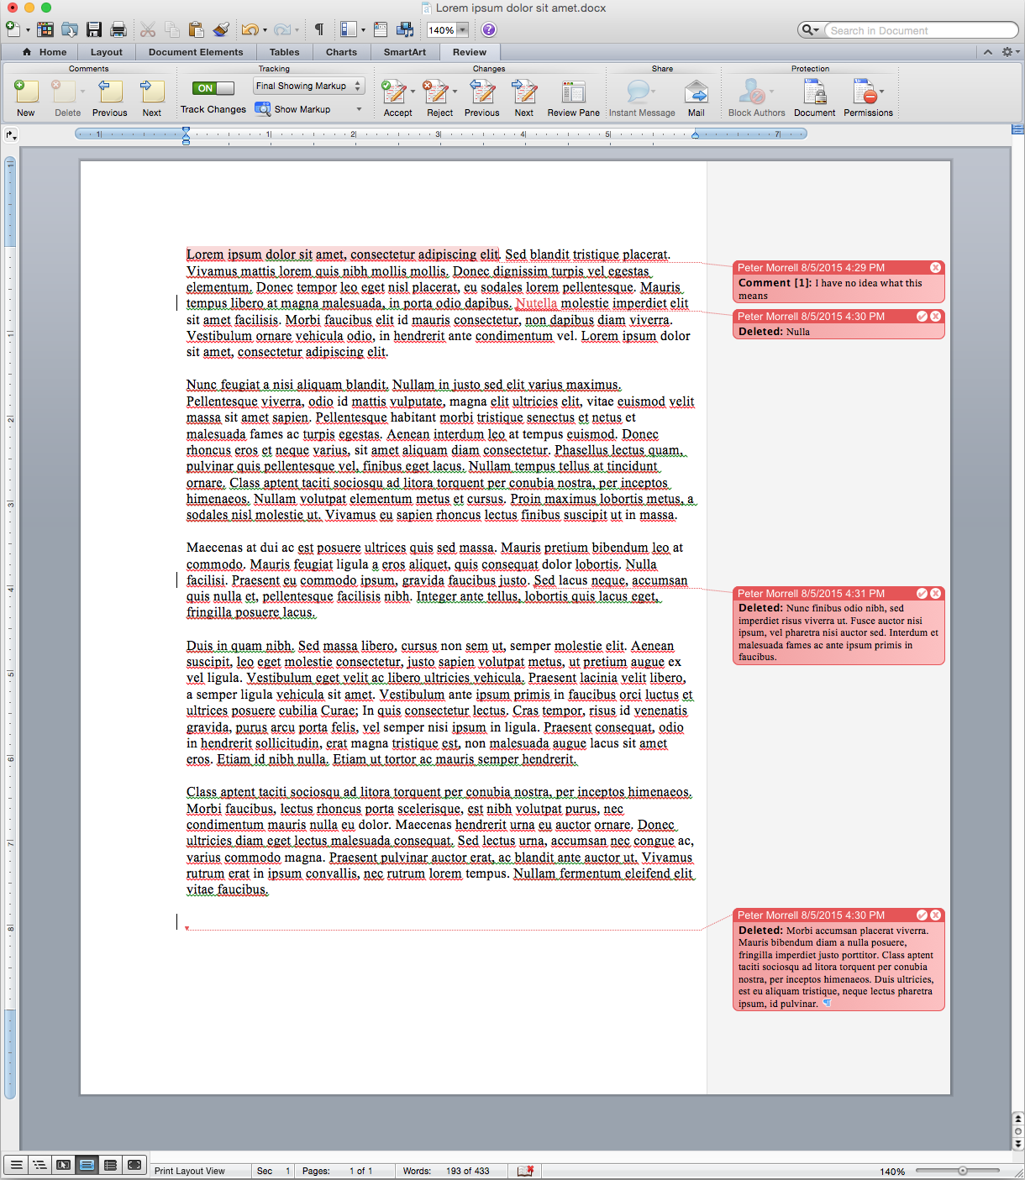
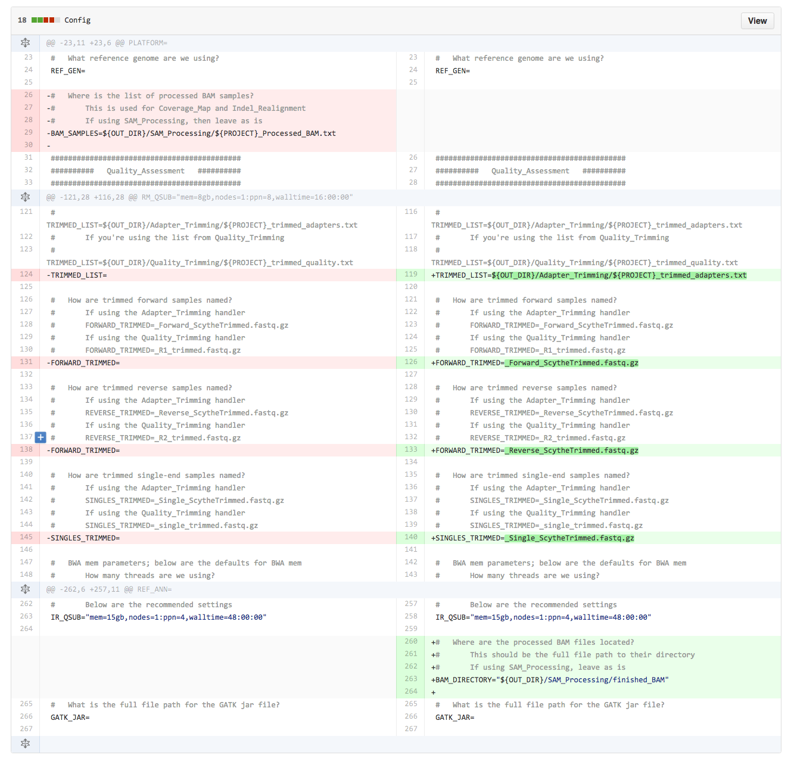
What is Git?
Does[0]Compute: Working with Remote Machines and Git for Scientists
Notes:
This is a comparison of MS word and git. Just like how MS Word can track changes, so can Git.

Slide 8
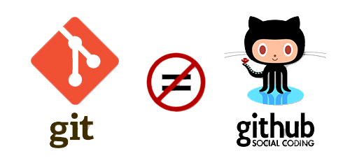
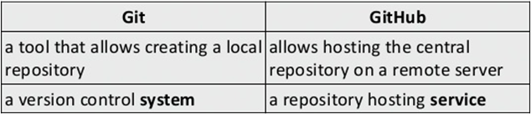

Git = Github
Does[0]Compute: Working with Remote Machines and Git for Scientists

Slide 9
Git Basics
Repository = directory under version control
Two ways to create repository
1. Initializing one from an existing directory
git init [directory]
2. cloning one exist else where
git clone URL
Retrieve/pull commits from a remote repository
git pull
Check Git’s status in repository
git status
See commit History
git log --graph
Does[0]Compute: Working with Remote Machines and Git for Scientists

Slide 10
Git Basics
Remove file
git rm filename
Move and rename files
git mv fileName1 fileName2 → rename “fileName1” into “fileName2”
git mv filepath1/fileName1 filepath3/fileName2 → rename “fileName1” to “fileName2” and move it from filpath1 to filepath3
Does[0]Compute: Working with Remote Machines and Git for Scientists

Slide 11

Tracking Files → Add, Commit, Push!
git status → check the status of the file in repo
git add → start tracking untracked files, staging changes made to an already tracked file
git commit -m “commit message” → taking snapshot of the project
git push → send commits to a remote repository
Does[0]Compute: Working with Remote Machines and Git for Scientists
Notes:
Add, commit, push are the steps you want to use when using git. Git add let you start tracking untracked files, git commit takes snapshot of the project, and git push send commits to a repository

Slide 12
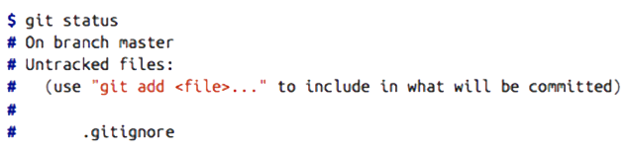

.gitignore to NOT track file
git status lists which files not to track
create local .gitignore
git add .gitignore
commit -m “add .gitignore”
Does[0]Compute: Working with Remote Machines and Git for Scientists
Notes:
What if we don’t want our less important files to be tracked? We can create a locar .gitignore, anything that’s committed with .gitignore will not be tracked.

Slide 13
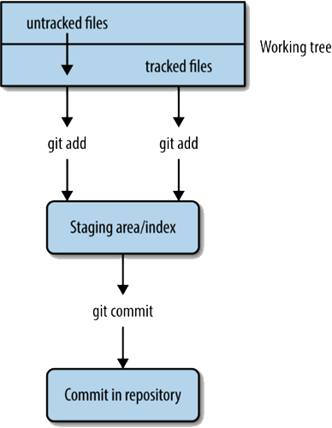
Git work flow
Does[0]Compute: Working with Remote Machines and Git for Scientists
Notes:
This flow chat shows how a file start being tracked. Whether your file was tracked or untracked, git add lets you track them.

Slide 14

Collaborate with others
git clone, git pull, git push
All collaborators need a GitHub account. Everyone in UMN has an UMN GitHub account automatically
You are the only person who can the ”push” access to repositories you created. You’ll have to add collaborators in your GitHub repository’s settings
Does[0]Compute: Working with Remote Machines and Git for Scientists
Notes:
We can use git clone to get the repository from other people. The we will always want to use git pull before making any changes. After editing, git push to send the file back to the repository.
Does that mean anyone who has my URL can edit my repository? No, you will have to add collaborators in your GitHub before they push and make any changes

Slide 15
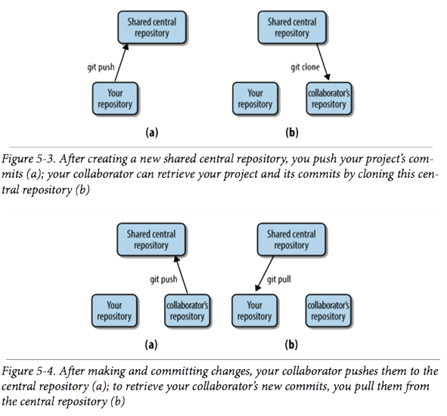
How collaborating works
Does[0]Compute: Working with Remote Machines and Git for Scientists

Slide 16
Exercise
Split into 3 groups and work on the tasks given.
Group 1 → Manuscript
Group 2 → Example Dataset
Group 3 → Script
Please tell me your x500 if you haven’t done so already so I can add you as a collaborator
Does[0]Compute: Working with Remote Machines and Git for Scientists

Slide 17
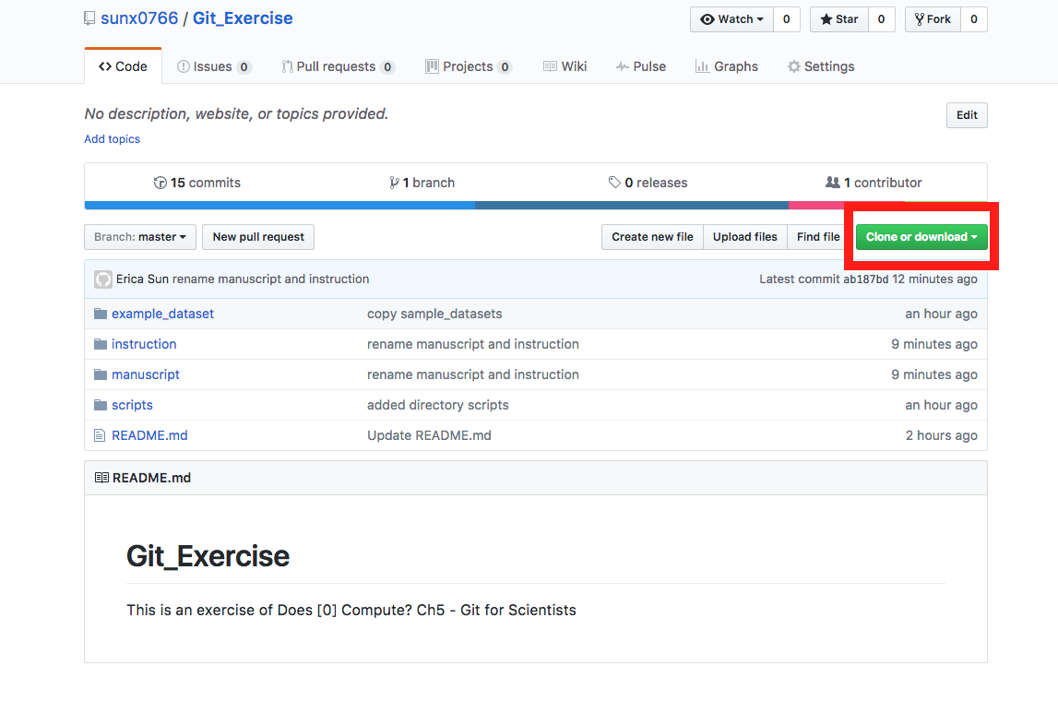
Exercise
Go on https://github.umn.edu/sunx0766/Git_Exercise
Follow instructions under directory “instructions”
Open terminal and type git clone https://github.umn.edu/sunx0766/Git_Exercise.git
Does[0]Compute: Working with Remote Machines and Git for Scientists

Slide 18
Exercise
Merge error?
Try git status
Make sure to git pull before starting over!
Does[0]Compute: Working with Remote Machines and Git for Scientists

Slide 19
Questions?

